Slide 1
How ordinality can
mess up our models and how we can use it to solve such problems
Dino Carpentras
COSS - Computational Social Science

Slide 2
How tall am I?
a) 1.80
b) 5.9
c) 5.8e-17

Slide 3
How tall am I?
a) 1.80
b) 5.9
c) 5.8e-17
1.80
of what?

Slide 4
How tall am I?
a) 1.80 m
b) 5.9 ft
c) 5.8e-17 parsec

Slide 5
New questions
Why do we ask for units for something as simple as height?
But do not ask any specification for something as complex as opinions?
Opinion x=0.6

Slide 6
New questions
Why do we ask for units for something as simple as height?
But do not ask any specification for something as complex as opinions?
0.6
of what?
Opinion x=0.6
Opinions have no units

Slide 7
Why opinions have no units?
Not because they are too simple
But because they are so complex we cannot even define a unit

Slide 8
Different types of data
Nominal
Ordinal
Interval
Ratio

Slide 9
Different types of data
Nominal
Ordinal
Interval
Ratio
Model’s variables

Slide 10
Different types of data
Nominal
Ordinal
Interval
Ratio
Real data
Model’s variables

Slide 11
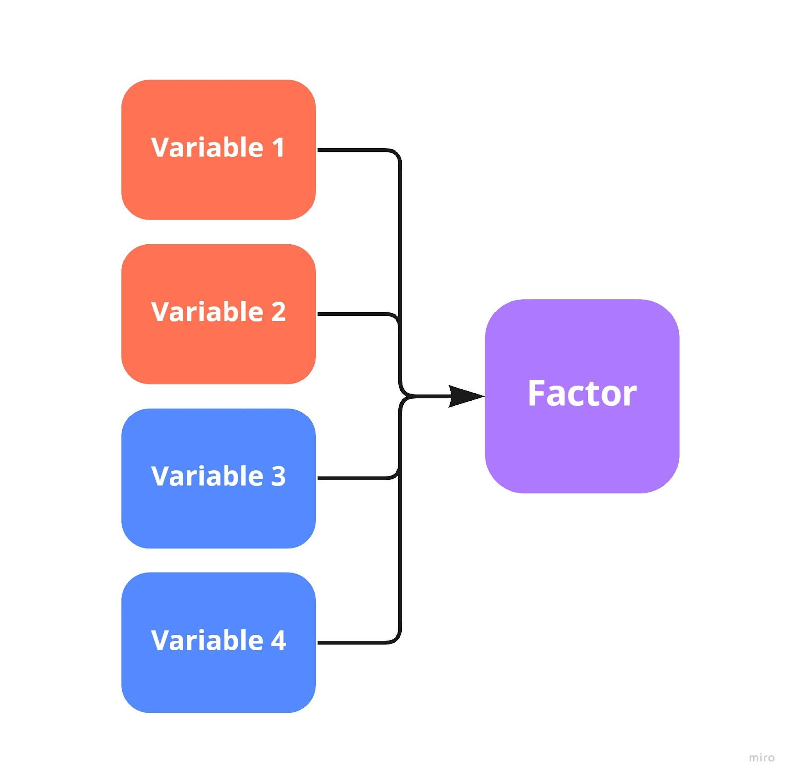
Ordinal will stay ordinal
Also treatments such as factor analysis or IRT will not solve the problem
Ordinal
Also ordinal

Slide 12
Ordinal is interval in disguise
Ordinality is not a property of the data
But a relationship between data and the construct
E.g. Smiling versus happines

Slide 13
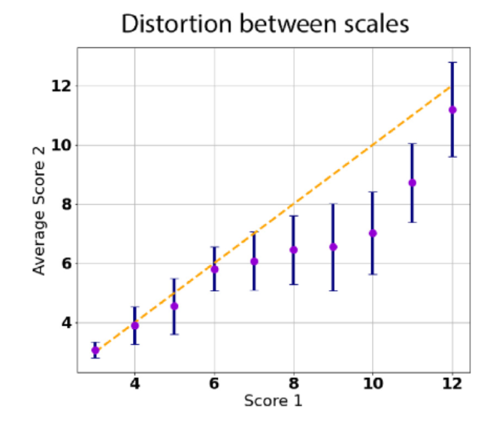
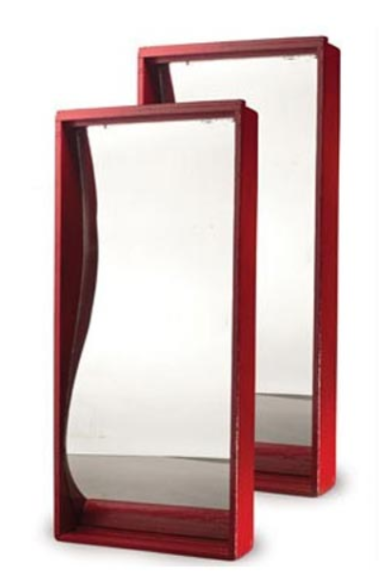
There is a relationship between ordinal and interval
Carpentras, D., & Quayle, M. (2022). Propagation of measurement error in opinion dynamics models: The case of the Deffuant model. Physica A: Statistical Mechanics and its Applications, 606, 127993.

Slide 14
You are not looking at the real object but at a distorted version of them

Slide 15
Every measurement is going to be different

Slide 16
The relationship is unknow
If you suppose a ground truth
… it has an unknown distortion
If you think there are only data
… you still have distortions from data to data

Slide 17
Different spaces
Every (processed) data are in a different “space”
My data
Your data

Slide 18
Different spaces
Every (processed) data are in a different “space”
My data
Your data

Slide 19
In physics
Undistorted lenses
Result
m
V1
Object
*1e-3
km
V2
parsec
V3
*3.24e-14

Slide 20
In psychometrics
Distorted lenses
Result
Scale1
V1
Object
Scale2
V2
Scale3
V3

Slide 21
Dynamic impact

Slide 22
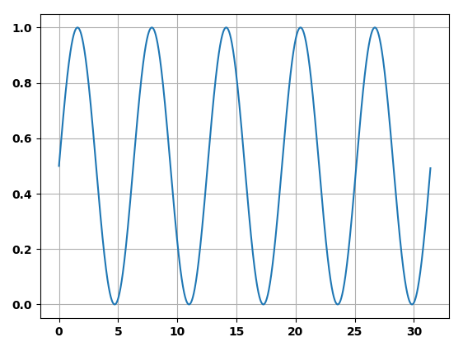
Version 1
$$y= Sin(t)$$

Slide 23
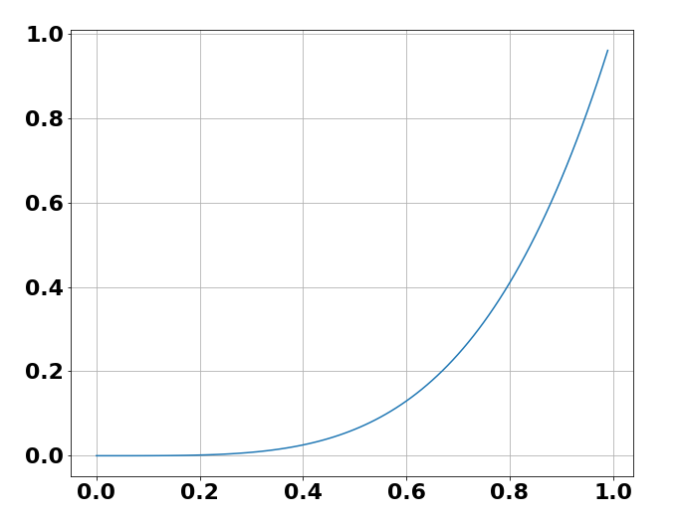
Version 2
h$(x)=x^{4}$

Slide 24
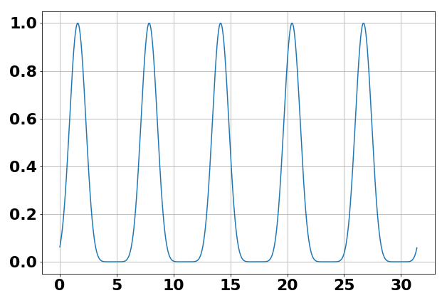
Version 2
h$(x)=x^{4}$
$$y= Sin^{4}(t)$$

Slide 25
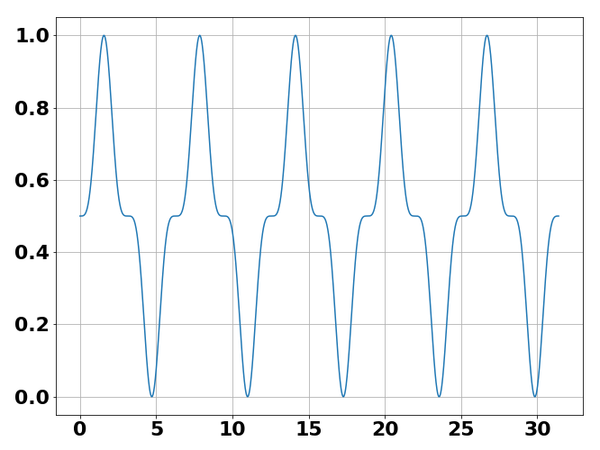
Version 3
$$y=h(Sin\left(t\right))$$

Slide 26
Applications to ABM
Space 1
(unaccessible to us)
People’s interaction follows the Deffuant model
Space 2
(the one of the data we collected)
People’s interaction may follow a very different behavior

Slide 27
Which one is the Deffuant model?
Eps=d=1, mu=0.5, N_agents=1000, N_iterations = 1000
a)
b)
c)
d)

Slide 28
First point
Possible dynamics
Observed dynamics
Real dynamics
Dyn 1
Dyn 3
Dyn x
Dyn 2

Slide 29
Indentify problems & solutions
Model
Good
scale
Good predictions
French data
Model
Poor
scale
Bad predictions
German data

Slide 30
What we thought before
Either your model fits the data or it does not
What we know now
Your model may be right in some spaces and wrong in others

Slide 31
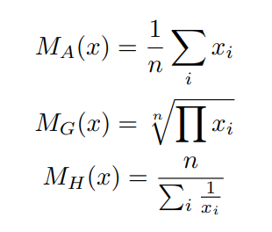
The models
3 models from Hegselmann & Krause

Slide 32
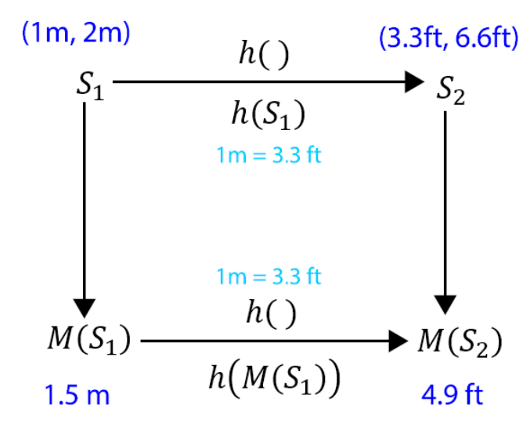
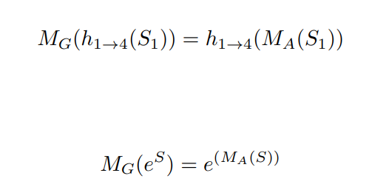
Example of equivalence

Slide 33
Models equivalence
Meas 1
Model 1
Sim ground truth
Meas 2
Model 2
Result
Meas 3
Model 3

Slide 34
Second point
Class of models
Model
Model 1
Model 3
Make the scale
As a parameter
Model 2

Slide 35
Possible dynamics
Observed dynamics
Real dynamics
Dyn 1
Dyn 3
Dyn x
Dyn 2
Class of models
Model
Model 1
Model 3
Model x
Model 2

Slide 36
Take home message
“You should not use ordinal data for interval variables”
“You can actually do it, but you need to test what happens when you apply non-linear transformations. Because they are equally valid measurements of the same construct.”

Slide 37
Quick mentions

Slide 38
Special interest groups (SIGs)
Experimental ABM
Strongly empirical modelling

Slide 39
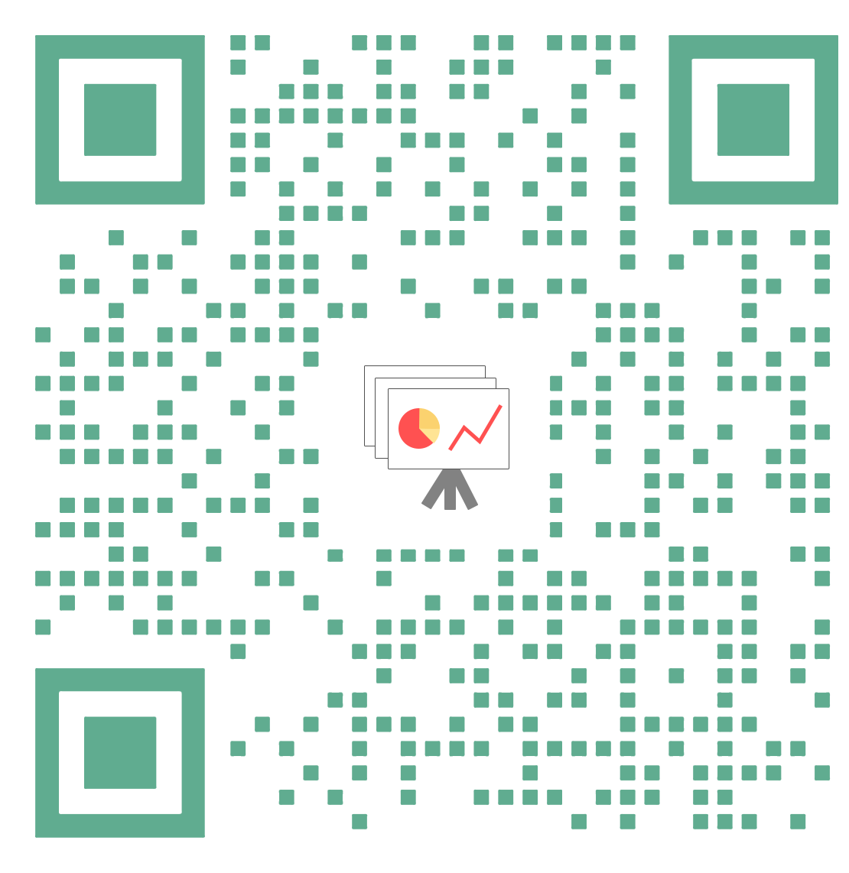
Contacts
www.dinocarp.com
dino.carpentras@gmail.com
@JustaNormalDino
Dino Carpentras
Readings
Carpentras, D., & Quayle, M. (2022). The psychometric house-of-mirrors: the effect of measurement distortions on agent-based models’ predictions. International Journal of Social Research Methodology, 1-17.

